Slide 1
USABILITY METRICS

Slide 2
USABILITY METRICS
Usability metrics are a system of measurement of the effectiveness, efficiency, and satisfaction of users working with a product. To put it simply, such metrics are used to measure how easy and effective the product is for users.

Slide 3
USABILITY METRICS
Usability metrics can:
(1) be cost and time effective
(2) address a wide variety of issues and products of any size
(3) be understood and appreciated by management.

Slide 4
ISO USABILITY STANDARD 9241
Adopts traditional usability categories:
effectiveness
can you achieve what you want to?
efficiency
can you do it without wasting effort?
satisfaction
do you enjoy the process?

Slide 5

1) Effectiveness
Effectiveness can be calculated by measuring the completion rate. Referred to as the fundamental usability metric, the completion rate is calculated by assigning a binary value of ‘1’ if the test participant manages to complete a task and ‘0’ if he/she does not.

Slide 6
Example:
Let us take a practical example: 5 users perform a task using the same system. At the end of the test session, 3 users manage to achieve the goal of the task while the other 2 do not. Using the above equation, the effectiveness of the system is worked out as follows:
Number of tasks completed successfully = 3
Total number of tasks undertaken = 5
Inserting the above values into the Effectiveness equation:

Slide 7

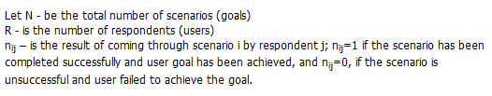
2) OVERALL USER EFFECTIVENESS
Overall user effectiveness of the product

Slide 8
Example 1
Example 1. 4 users work with a product according to 1 scenario. Three users complete the scenario successfully and one user fails.
Overall user effectiveness of the product
E = ((3*1 + 1*0)/(4*1))*100% = 75%.

Slide 9
Example 2
Example 2. 2 users work with a product according to 2 scenarios. The first user has completed scenario 1 successfully yet failed to complete scenario 2. The second user has failed with scenario 1 yet completed scenario 2 successfully.
Overall user effectiveness of the product
E = ((1*1 + 1*1 +1*1+ 1*0)/(2*2))*100% = 50%.

Slide 10
Example 3
Example 3. 11 users work with a product according to 5 scenarios. The first scenario has been successfully completed by 8 users, the second one by 6 users, the third one by 10, the forth one by11, and the fifth one by 4 users.
Overall user effectiveness of the product E = ((8+6+10+11+4)/(11*5))*100% = 71%.

Slide 11
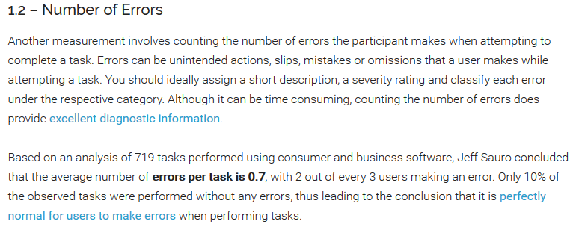
3) Error Rate

Slide 12
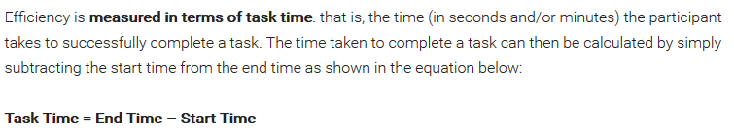
4) Usability Metrics for Efficiency
Efficiency can then be calculated in one of 2 ways:
1- Time-Based Efficiency
2- Overall Relative Efficiency

Slide 13
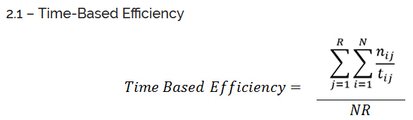
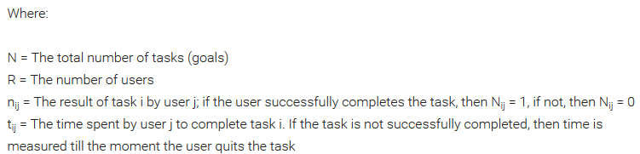

Slide 14
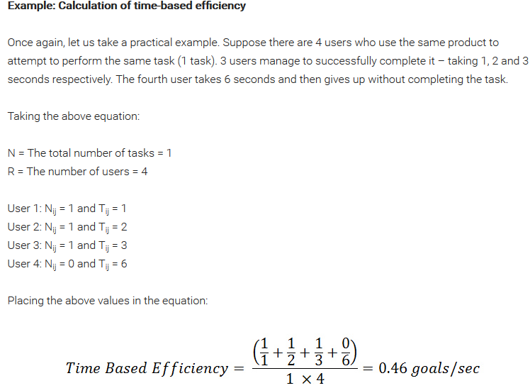
Example 1

Slide 15
Example 2
Users work with a product according to 1 scenario. Three users complete the scenario successfully and one user fails. Scenario completion time with the first user is 1 sec, 2 sec with the second user, 3 sec with the third one, and 10 sec with the fourth (unsuccessful) one. Time-based Efficiency Pt= (1/1 + 1/2 + 1/3 + 0/10) / (1*4) = 11/24 (goals/sec)

Slide 16
Example 3
2 users work with a product according to 2 scenarios. The first user has completed scenario 1 successfully yet failed to complete scenario 2. Scenario 1 completion time is 1 sec, the time before interruption of scenario 2 is 8 sec. The second user has failed with scenario 1 yet completed scenario 2 successfully. The time before interruption of scenario 1 is 10 sec, scenario 2 completion time is 4 sec. Time-based Efficiency Pt= (1/1 + 0/8 + 0/10 + 1/4) / (2*2) = 5/16 (goals/sec)

Slide 17
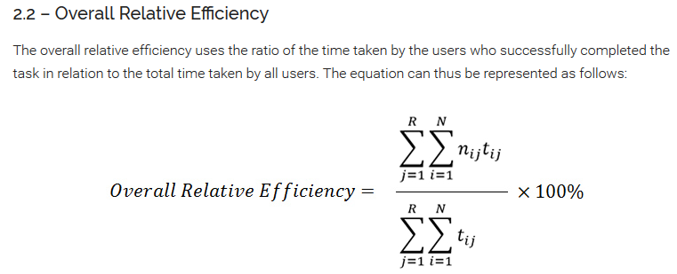
5) Overall Relative efficiency

Slide 18
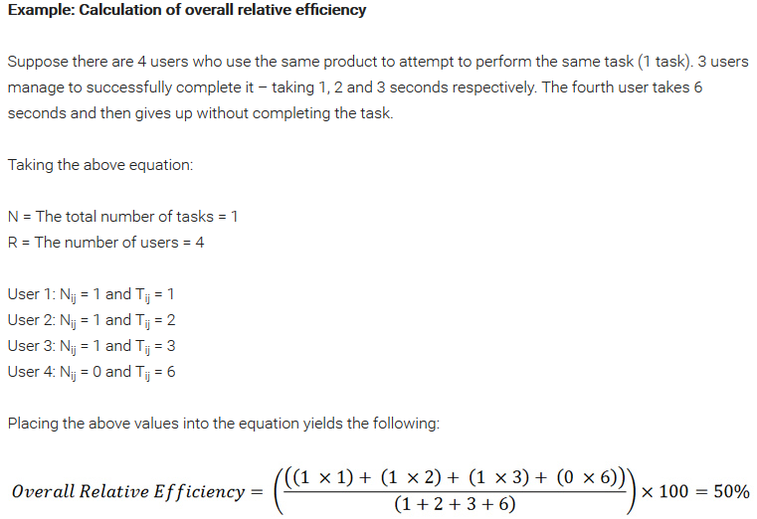
2) Usability Metrics for Efficiency

Slide 19
Example 1
Example 1. 4 users work with a product according to 1 scenario. Three users complete the scenario successfully and one user fails. Scenario completion time with the first user is 1 sec, 2 sec with the second user, 3 sec with the third one, and 10 sec with the fourth (unsuccessful) one. Expert completes the scenario in 1 sec. Overall relative Efficiency P = ((1*1 + 1*2 + 1*3 + 0*10)/(1 + 2 + 3 + 10))*100% = 37.5%

Slide 20
Example 2
2 users work with a product according to 2 scenarios. The first user has completed scenario 1 successfully yet failed to complete scenario 2. Scenario 1 completion time is 1 sec, the time before interruption of scenario 2 is 8 sec. The second user has failed with scenario 1 yet completed scenario 2 successfully. The time before interruption of scenario 1 is 10 sec, scenario 2 completion time is 4 sec. Expert completes scenario 1 in 1 sec, scenario 2 in 2 sec.
Overall relative Efficiency P = ((1*1 + 0*8 + 0*10 + 1*4)/(1 + 8 + 10 + 4))*100% = 21.7%

Slide 21
6) Satisfaction
User satisfaction is measured through standardized satisfaction questionnaires which can be administered after each task and/or after the usability test session.
6.1 – Task Level Satisfaction
After users attempt a task (irrespective of whether they manage to achieve its goal or not), they should immediately be given a questionnaire so as to measure how difficult that task was. Typically consisting of up to 5 questions, these post-task questionnaires often take the form of Likert scale ratings and their goal is to provide insight into task difficulty as seen from the participants’ perspective.

Slide 22
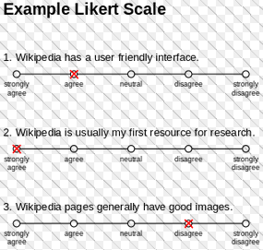
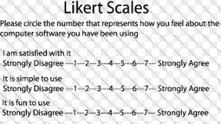
6) Satisfaction

Slide 23
6) Satisfaction or Success Rate
The most popular post-task questionnaires are:
ASQ: After Scenario Questionnaire (3 questions)
NASA-TLX: NASA’s task load index is a measure of mental effort (5 questions)
SMEQ: Subjective Mental Effort Questionnaire (1 question)
UME: Usability Magnitude Estimation (1 question)
SEQ: Single Ease Question (1 question)

Slide 24
6) Satisfaction
6.2 – Test Level Satisfaction
Test Level Satisfaction is measured by giving a formalized questionnaire to each test participant at the end of the test session. This serves to measure their impression of the overall ease of use of the system being tested.

Slide 25
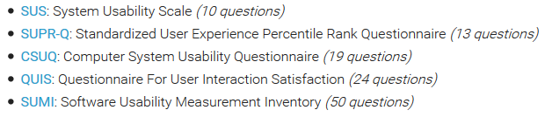
6) Satisfaction
For this purpose, the following questionnaires can be used:

Slide 26
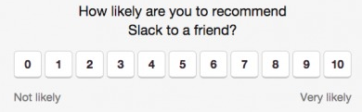
Net Promoter Score (NPS) is calculated by asking one question…

Slide 27
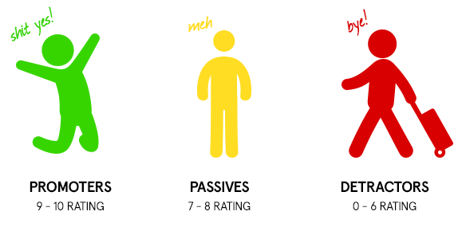
Net Promoter Score (NPS)

Slide 28
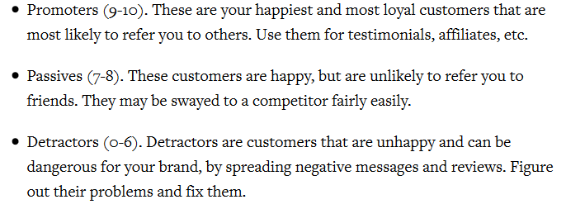
Net Promoter Score (NPS)

Slide 29
Several variations or types of usability metrics
There are several variations or types of usability metrics that can be measured including:
performance metrics
issues-based metrics
behavioral metrics and physiological metrics

Slide 30
a) Performance Metrics
Task success – how effectively users are able to complete a given set of tasks
Time-on-task – how much time is required to complete a task
Errors – mistakes made during a task. Errors are useful in pointing out particularly confusing or misleading parts of a product, process or interface.
Efficiency – amount of effort a user spends to complete a task
Learnability – how performance changes over time

Slide 31
b) Issues-based metrics
What prevents task completion by a user
What distracts a user
What creates confusion for a user
What produces an error for a user
What causes something not to be noticed
Why a user will assume something is correct when it is not
Why a user will assume a task is complete when it is not
Why a user performs a wrong action
Why a user misinterprets content
Why a user does not understand navigation

Slide 32
c) Behavioral and physiological metrics
Verbal Behaviors:
Positive and negative comments,
Suggestions for improvement
Questions
Variation from expectations
Confusion
Frustration
Non-Verbal Behaviors:
Facial expressions
Body language
May require special equipment to capture data

Slide 33
Success Rate: The Simplest Usability Metric
Simplified success rates are best used to provide a general picture of how your site supports users and how much improvement is needed to make the site really work.

Slide 34
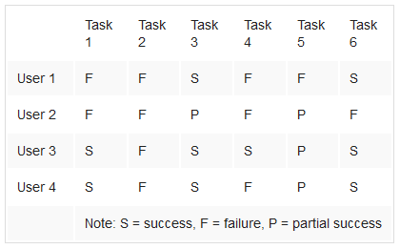
Success Rate: The Simplest Usability Metric
The following table shows task success data from a study. In it, the researchers tested a fairly big content site, asking four users to perform six tasks.
Total Users Tu
Total Attempts to Perform Tasks Tp
Successful Attempts S
Partial Attempts P
Success Rate= [(S+ (Tu*0.5))/Tp]x 100

Slide 35
Success Rate: The Simplest Usability Metric
Total Tasks = 6
Total Users Tu= 4
Total Attempts to Perform Tasks Tp= 24
Successful Attempts S= 9
Partial Attempts P= 4

Slide 36
Success Rate: The Simplest Usability Metric
Success Rate= [(S+ (Tu*0.5))/Tp]x100
= [(9+(4*0.5))/24]x100
= 46%

